Slide 1


Water Quality Prediction Using Machine Learning
PRESENTED BY
JAI AVINASH MJ
24AD073
Notes:
1

Slide 2
Problem Identification
Health Impacts
Outdated Methods
Water is essential for human life, and its quality directly impacts health, with contaminants leading to severe illnesses.
Traditional water testing methods are manual, time-consuming, and expensive, hindering frequent monitoring.
Monitoring Gaps
Urgent Need
Many areas lack regular water quality monitoring, increasing risks of waterborne diseases due to undetected contamination.
There is a critical need for an automated system to quickly and accurately predict water quality based on measurable parameters.
Notes:
2

Slide 3

Objectives
1
Predictive Modeling
Develop a Machine Learning model to classify water as potable (drinkable) or non-potable using chemical and physical parameters.
2
Accuracy Focus
Achieve high accuracy by experimenting with diverse ML algorithms and optimizing model performance.
3
Accessible Solutions
Provide an easy-to-use solution for government agencies, industrial entities, and the general public, empowering better water management.
Notes:
3

Slide 4





Technical Stack
Python
Data Handling & Viz
Machine Learning
The core programming language for development, leveraging its robust ecosystem for data science.
Pandas and NumPy for efficient data manipulation; Matplotlib and Seaborn for compelling data visualization.
Scikit-learn, the industry standard for implementing various machine learning algorithms.
Kaggle Dataset
Development Env.
Utilizing the Kaggle Water Quality Dataset as our primary source of raw data.
Jupyter Notebook and Google Colab for interactive development and collaborative coding.
Notes:
4

Slide 5





Our Process: From Data to Prediction
Prepare Data
Predict
Collect Data
Train Model
This systematic approach ensures robust model development and reliable water quality predictions.
Notes:
5

Slide 6
Literature Survey
Alghamdi et al., 2020
Random Forest & ANN for water quality prediction
Random Forest outperformed ANN with 85% accuracy, highlighting its suitability for such tasks.
Sharma & Kumar, 2019
Logistic Regression & Decision Trees
Achieved 82% accuracy using 8 water parameters, demonstrating the efficacy of simpler models.
Singh et al., 2021
Ensemble Learning methods
Improved accuracy to 88% with feature selection, emphasizing the power of combining models.
These studies provide a strong foundation and benchmarks for our model development.
Notes:
6

Slide 7
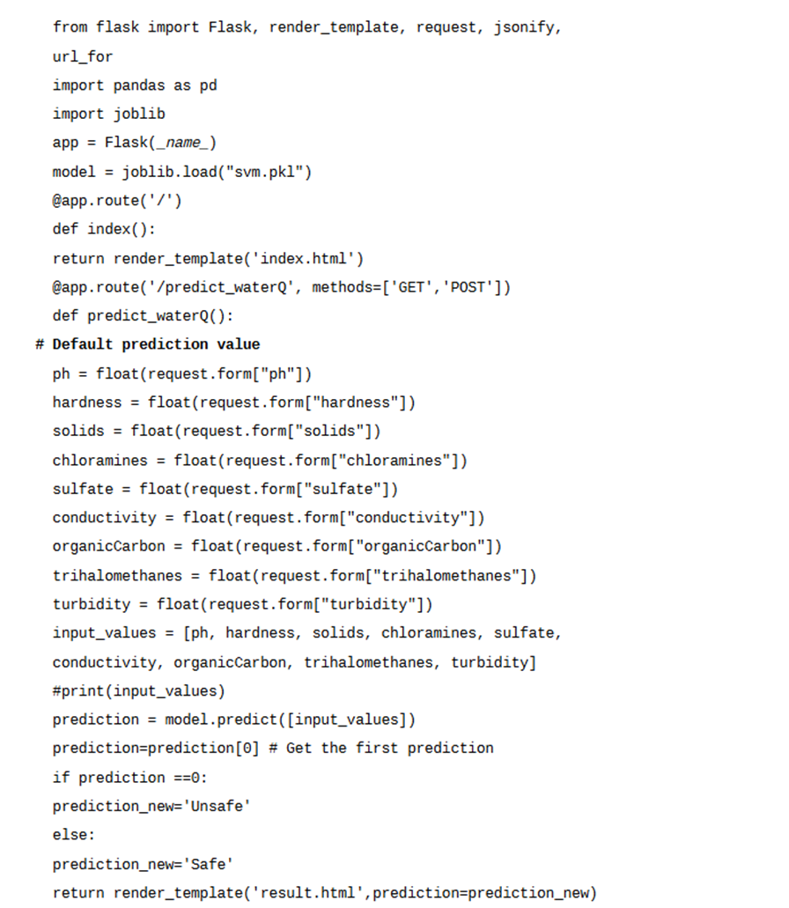
CODE IMPLEMENTATION
app.py

Slide 8
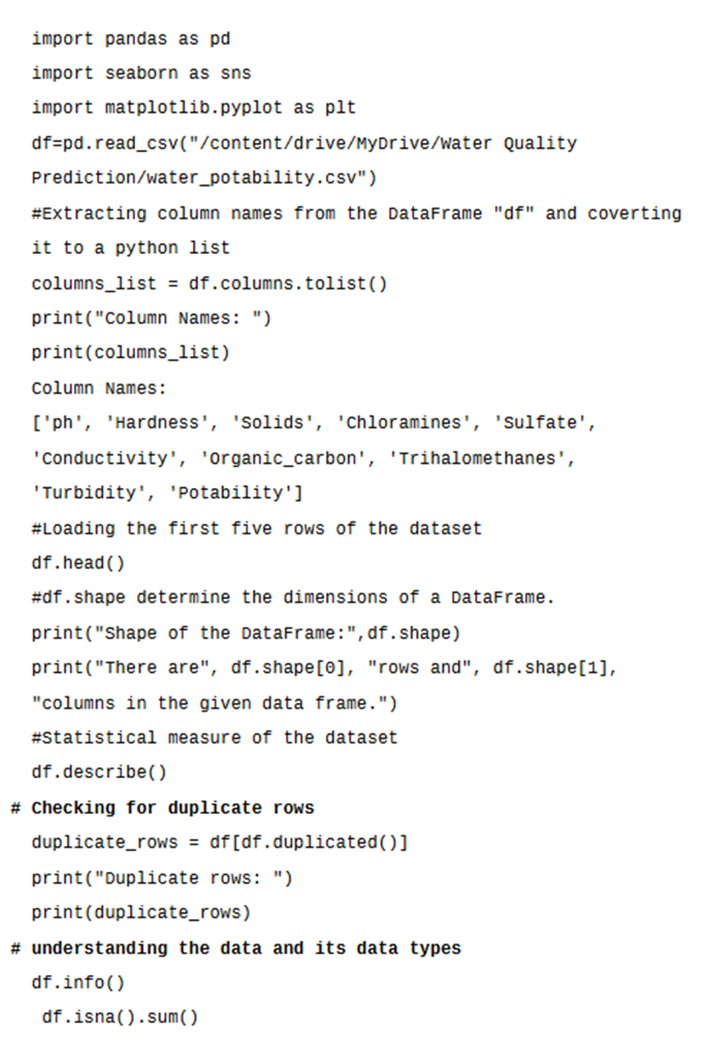
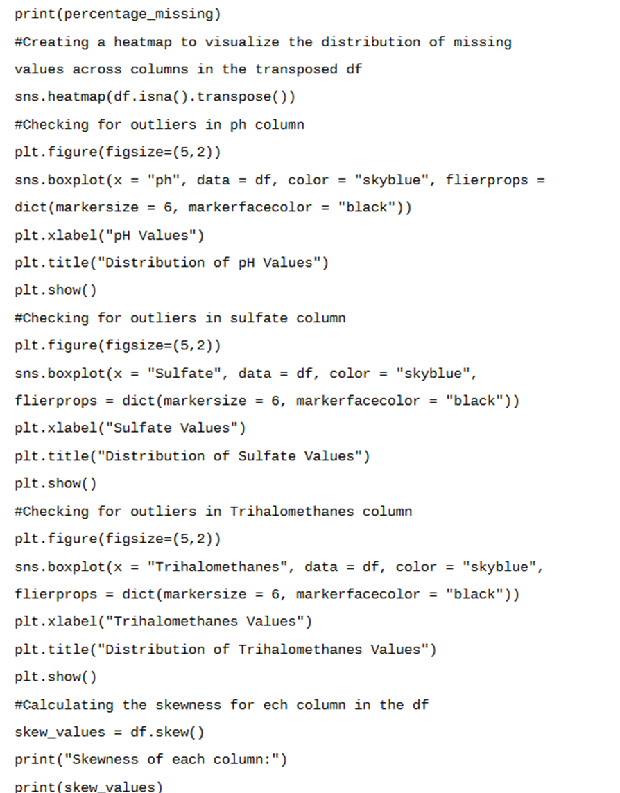
MODEL TRAINING CODE

Slide 9
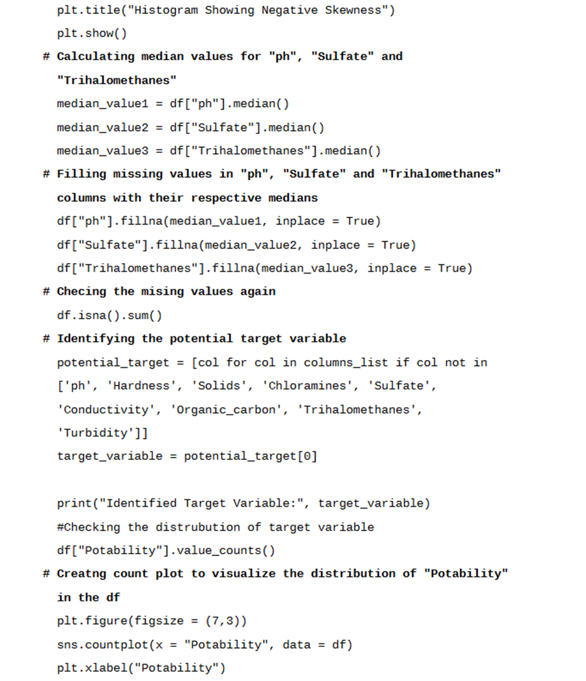
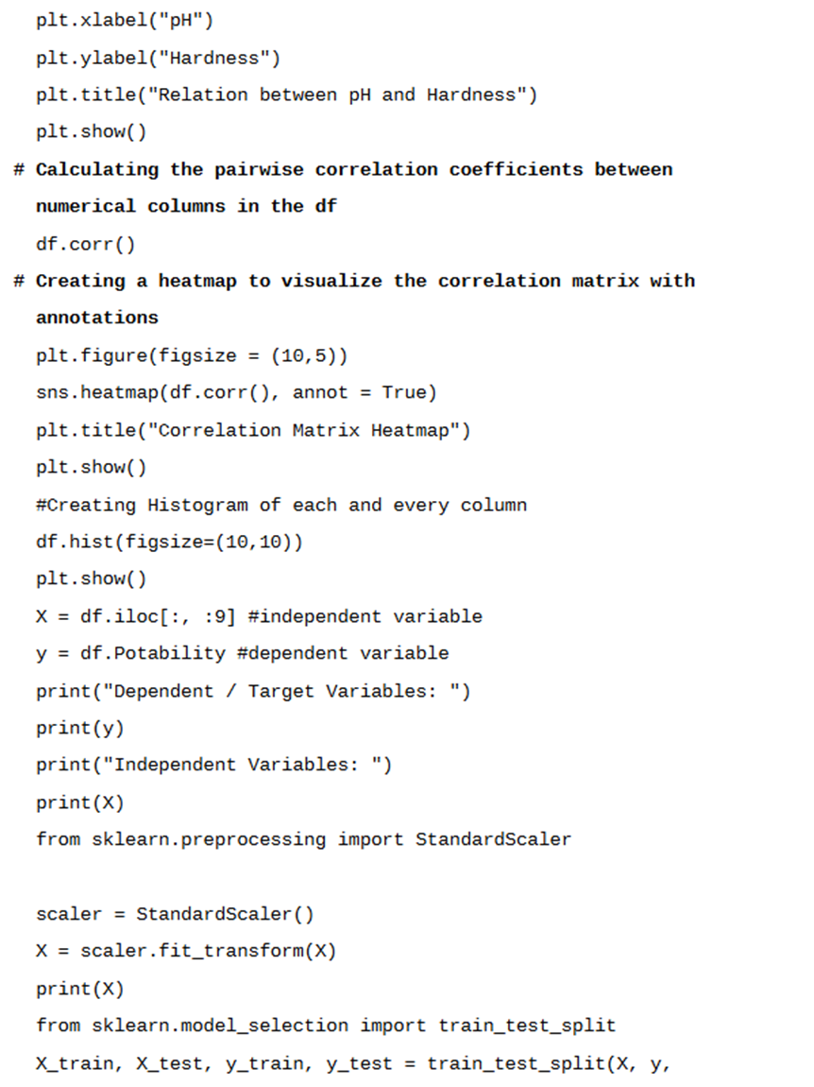
MODEL TRAINING CODE

Slide 10
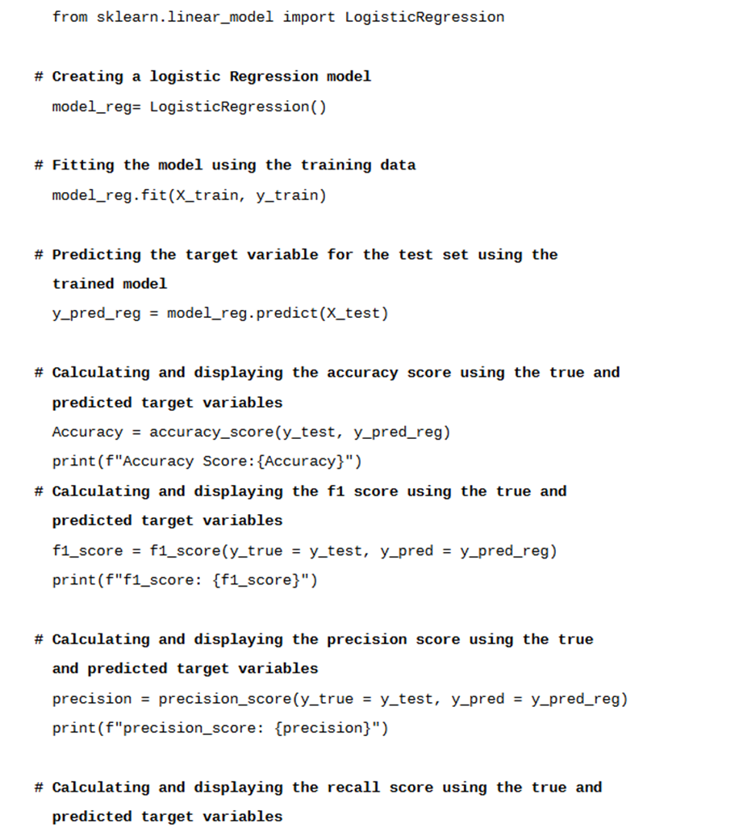
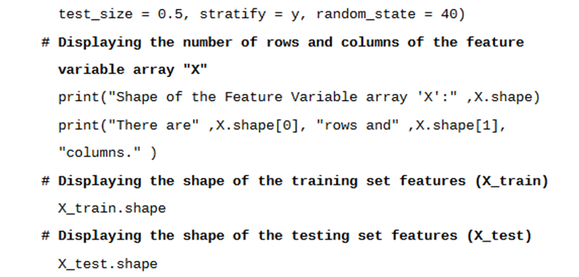
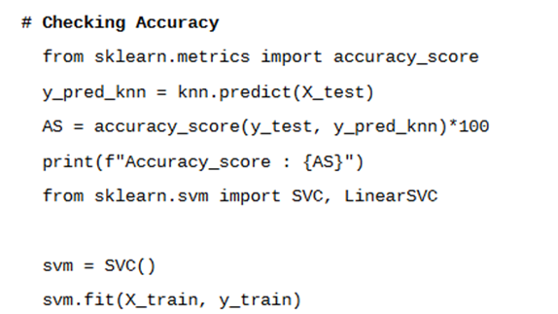
MODEL TRAINING

Slide 11
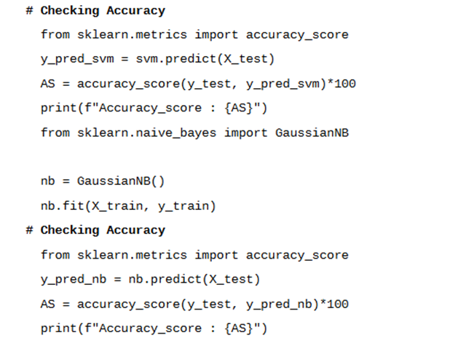
MODEL TRAINING

Slide 12
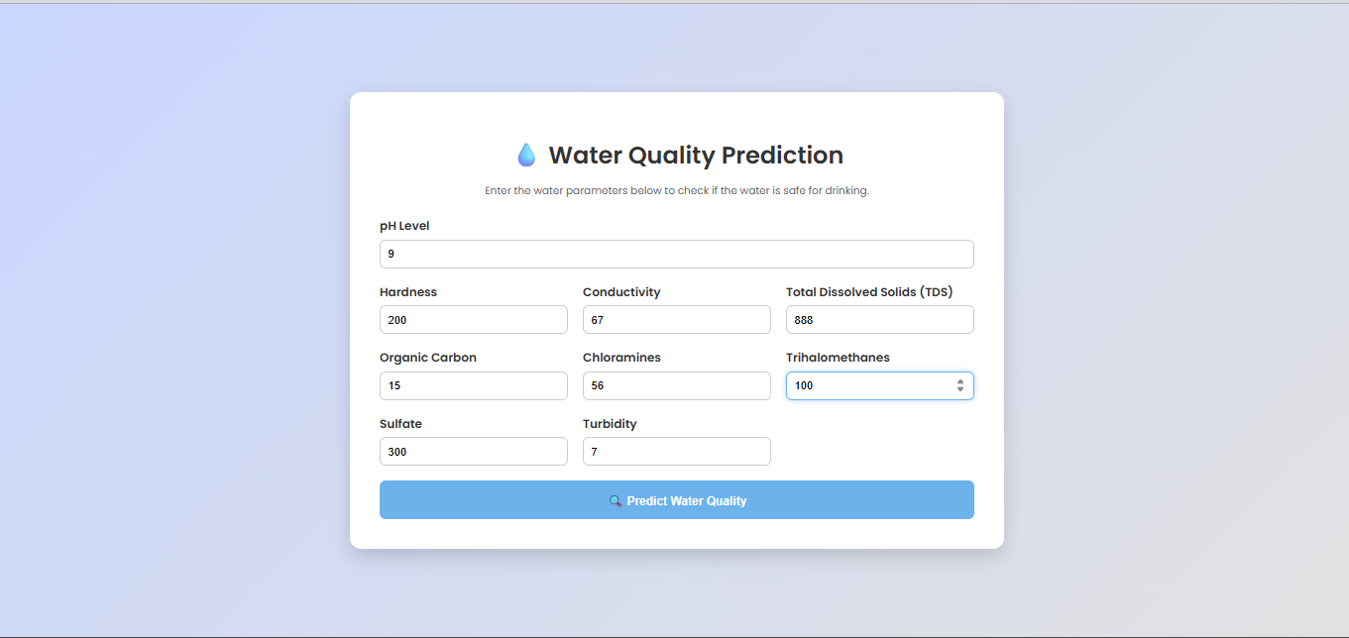
OUTPUT

Slide 13

OUTPUT

Slide 14
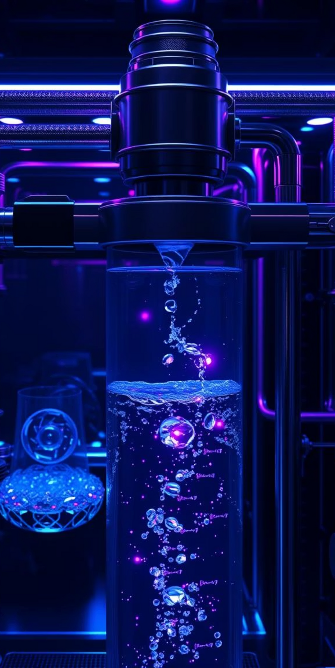




Conclusion: Towards Smarter, Safer Water Management
100%
Transformation to proactive water quality management.
95%
Cost-effective, accurate, and timely water safety decisions.
88%
Collaboration among scientists, policymakers, and technologists for resource safeguarding.
92%
Future of water quality monitoring is intelligent, automated, and accessible.
Notes:
9

Slide 15
References
Kaggle Water Quality Dataset: https://www.kaggle.com/datasets/adityakadiwal/water-potability
Alghamdi, T. A., et al. "Machine learning for water quality prediction." Water 12.1 (2020).
Sharma, R., Kumar, S. "Predictive analysis of drinking water quality." IJERA (2019).
Singh, P., et al. "Ensemble methods for water potability prediction." Springer (2021).
Notes:
7

